Slide 1

Client-Side Programming
Day 8

Slide 2

Welcome Message
Hazard Recognition Course​
Week 1- Summary​
Hazard Recognition Course​
Week 1- Summary​

Slide 3
Introduction to CSS
• Using Cascading Style Sheets with XHTML
• Getting CSS into XHTML
• Adding more style tags
• Stylizing the heading
• Defining Selectors in CSS

Slide 4
Using Cascading Style Sheets with XHTML
We have already seen CSS in action with XHTML, and have seen what it can do.
CSS provides the style for the document whereas XHTML provides the structure.
We will want to organize our CSS as best as possible, by putting it in a separate style sheet file.
This will allow us to keep our code cleaner and easier to work with.

Slide 5
Getting CSS into XHTML
Adding a separate style sheet is easily done within the <head> tags.
The <link> tag is used:
<link href=“css/style.css” rel=“stylesheet” />
It is a good idea as well to place the css files in their own folder (named css here) to keep your site more organized.
For smaller sites organization can seem easy with few files, but as a site grows you will quickly find that having different types of files (css, javascript or images) in their own folders makes things a lot easier to manage.

Slide 6
Getting CSS into XHTML
Demo Separate Style Sheet
separatecss.html and css/separatecss.css

Slide 7
Adding more style tags
You can link as many style sheets as necessary, although the more documents you load, the slower your site will respond because it has to download each individual file.

Slide 8
Adding more style tags
CSS is processed like a cascading waterfall (Cascading Style Sheets)
The style sheets are processed from the top of the document to the bottom.
External linked style sheets get least priority in the style that is applied to an element.
The style tags we add get the second priority in the style of an element.
The style attribute gets top priority in styling an element.

Slide 9
Adding more style tags
Even though the style attribute gets top priority, it is still better to use the external style sheets first, before using the style tags or attributes.
This will keep code cleaner, and easier to read and maintain.
Hunting down stray style attributes that are producing an unwanted effect is time consuming.

Slide 10
Adding more style tags
Setting an element with a style attribute requires copying the element and pasting it.
Then when it comes time to make a change, all the elements with that style tag have to be edited.
By selecting all text boxes, for example, you only have to edit the style in one place.
input[type=“text”]{ /* Styling All Text Boxes */
border:solid 2px red; }

Slide 11
Adding more style tags
Demo CSS priority Demo
separatecsspriority.html

Slide 12
Stylizing the heading
To continue with our layouts, lets stylize our header (and footer) using a fixed position.
We can place the header and footer outside the main content area if we wish, but will have to accommodate the area taken up by these elements.
This type of layout allows us to scroll through the content, but have the menu and footer stay visible.

Slide 13
Stylizing the heading
Stylizing Header Demo
stylizingheader.html and css/headerstyle.css

Slide 14
Using Padding, Borders and Margins
Padding is the area inside an element, it can give text some breathing room before the border.
Borders are right on the edge of the element.
Margins specify spacing around the elements, to give them breathing room from other elements.
This is known as the CSS Box Model.

Slide 15
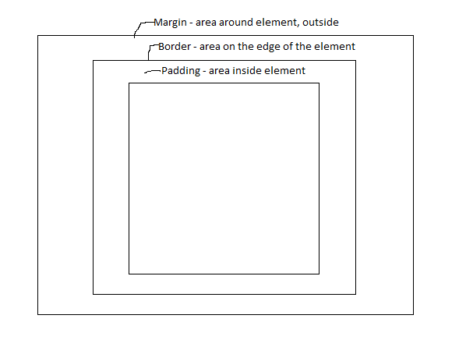
Using Padding, Borders and Margins

Slide 16
Using Padding, Borders and Margins
We can add dimensions to the top, bottom, left or right, of padding borders or margins, or add to all sides using one style attribute.
padding-top:10px; /*gives element top 10pixels of padding */
margin-bottom:10px; /*gives element bottom 10 pixels of margin*/
padding:10px /*gives all sides 10px of padding*/

Slide 17
Using Padding, Borders and Margins
Keep in mind that adding any dimensions to the box model will add to total overall pixels for the element.
For example:
width:100px; padding:20px; margin:20px;
border: solid 1px black;
Adding together the dimensions we have
100 + (20 x 2) + (20 x 2) + (1 x 2)
(width plus padding on both sides, margin on both sides and border on both sides)
the total width is 182 pixels.

Slide 18
Using Padding, Borders and Margins
Most browsers will now support “box-sizing” as we have seen before, which will allows us to include the box model dimensions along with our width and height and not add any extra pixels.
Always test on the widest range of browsers possible, or ones specifically targeted for a particular business.
For example, a lot of businesses use Internet Explorer exclusively, and older versions will not support box-sizing.
In these cases calculating the box model size is important and necessary to have proper related objects.

